Slide 1
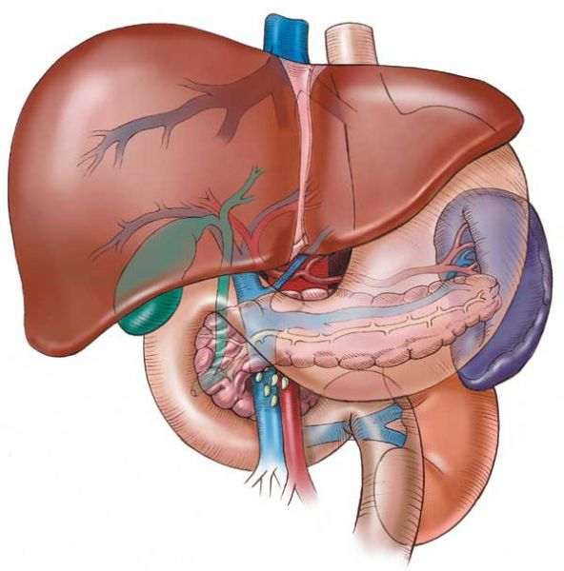
Histology
Glands of the digestive system
By: Dr. Ammar Ismail

Slide 2
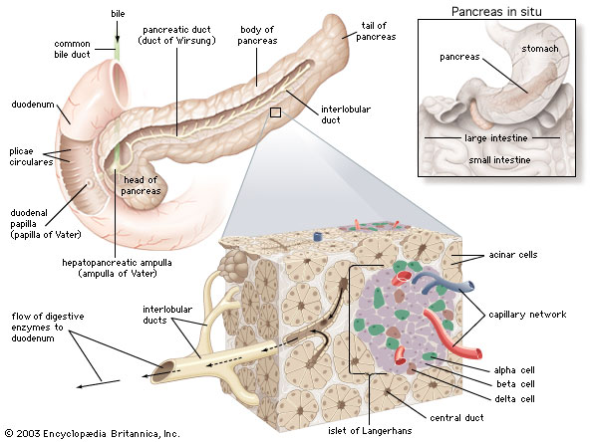
Pancreas
The pancreas is an exocrine gland that produces digestive juices( amylase, lipase ,trypsin ) and an endocrine gland that manufactures hormones .
Its compound tubuloacinar gland surrounded by capsule which gives trabiculi to divides the parenchyma into lobules which contain two types of secretary unit.

Slide 3
Pancreas
1 – Exocrine units : (acini )
The pancreatic acini is spherical shape formed from cuboidal cells have central nuclei . the acini of pancreas have no basket cells ( myoepithelial cells).
The duct system of pancreas begins with in the center of acinus which open to the intercalated duct which composed of pale low cuboidal , intercalated ducts join each other to form larger intralobular ducts lined by stratified cuboidal epithelium and this lead to interlobular ducts , also these later duct connect into main pancreatic duct which join the common bile duct before opening in the duodenum .

Slide 4
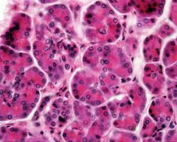

Slide 5
Pancreas
2 – Endocrine units :
Its composed of spherical aggregates of cells , known as islets of langerhans, that are scattered among the acini .There are five cell types composing the islets of langerhans :Alpha , Beta , Delta , PP cells and G-cells These cells cannot be differentiated from each other by rotten histological examination . These five cells types responsible for synthesis, Insulin ,Glacogon , somatostatine , Gastrin , pancreatic polypeptide .

Slide 6
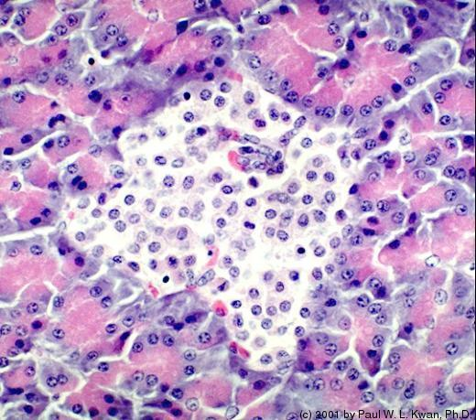

Slide 7
Liver :
The liver is a largest gland in the body its surrounded by mesothelium .The connective tissue capsule extend into the gland and divided it into lobes and lobules . The parenchyma of liver is consist of epithelial cells of endodermal origin, the hepatocytes arranged in anastomosing rows separated by sinusoids converging on the central vein , the sinusoids are lined with fenestrated endothelial cells and macrophages (Kupffer cells ).
The bile is secreted by each hepatocytes into the bile canaliculi , that are lined with the plasma membrane of the hepatocytes between adjacent liver cells . Its flows from there the bile ducts are lined with cuboidal epithelium in the portal areas .
Note : The smallest functional unite of liver is acini .

Slide 8
